Slide 1
Regions

Slide 2
Formal
common factor easily recognized
• language, religion, nationality, political identity or culture
• climate, landform, or vegetation.
• capital city, states, regions.

Slide 3
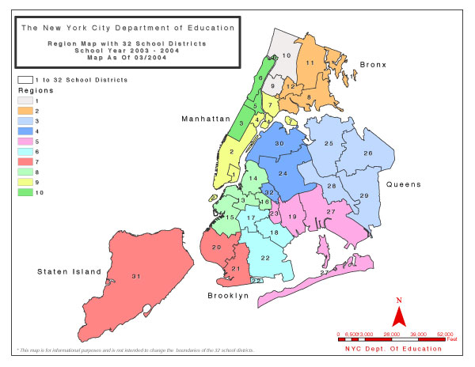
Functional
Share an activity in common
• Transportation system
• Education District
• All the capitals of the U.S

Slide 4
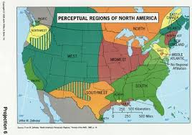
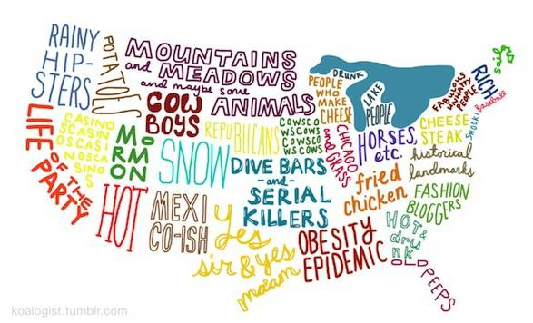
Vernacular/Perceptual
Mental map
• Bible belt
• Chinatown
• Wine Country

Slide 5
Map Projections and
Map Scale

Slide 6
All Maps Lie....
Because the world is a sphere and maps are flat, there will always be some degree of distortion. All flat maps have some distortion in their representation of:
Distance
Shape
Area
Or Direction
The next several slides will display some of the more popular distortions.

Slide 7
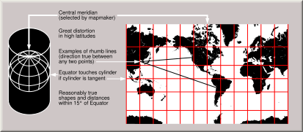
Cylindrical map projection
Useful for navigation because it maintains accurate direction
Famous for distortion in area that makes landmasses at the poles appear oversized

Slide 8
Cylindrical map projection
Attempts to retain accurate sizes of all landmasses
Sometimes used as a political statement- that we should refocus our attention to the tropics, home to large landmasses and many of the world’s poorest countries.
**West Wing

Slide 9
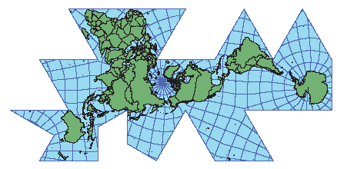
Fuller Projection
Maintains the accurate size and shape of landmasses
Completely rearranges direction such that the 4 cardinal directions (N,S,E,W) no longer have any meaning.

Slide 10
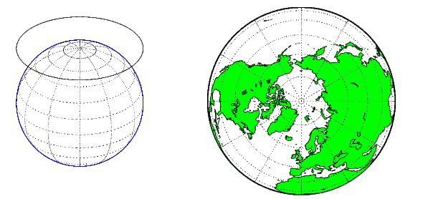
Azimuthal Projection
Planar
  Formed when a flat piece of paper is placed on top of the globe and a light source projects the surrounding areas onto the map.
Either the North Pole or South Pole is oriented at the center of the map which gives the viewer the impression of looking up or down at the earth.

Slide 11
Attempts to balance several possible projection errors.
Does not maintain completely accurate area, shape, distance, or direction, but it minimizes errors in each.
Used by National Geographic

Slide 12
https://www.youtube.com/watch?v=n8zBC2dvERM

Slide 13
Types of
Maps

Slide 14
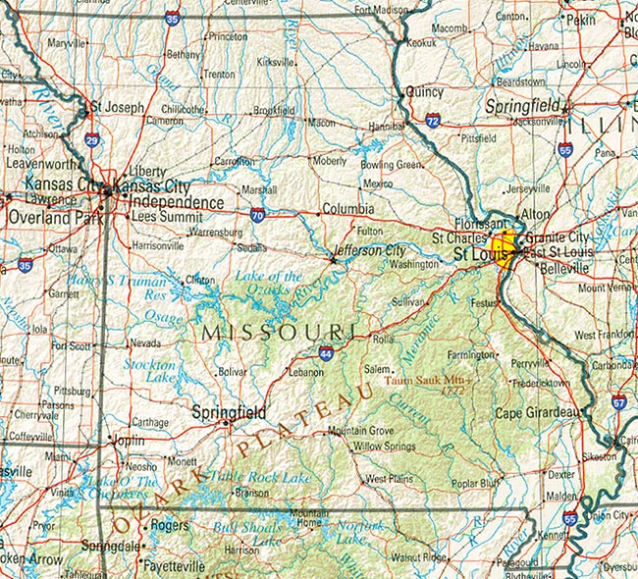
Reference Map
Show locations of places and geographic features.

Slide 15
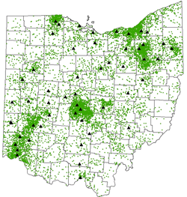
Dot Map
A dot may be used to locate each occurrence of a phenomenon.
Where appropriate, a dot may indicate any number of entities, for example, one dot for every 100 voters.
Military families in Ohio

Slide 16
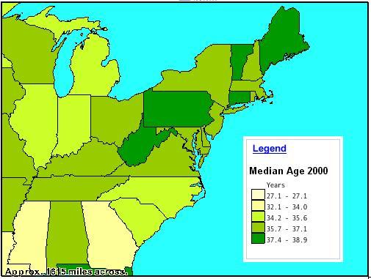
Thematic Map
Tells a story about the degree of an attribute, the pattern of its distribution, or its movement.

Slide 17
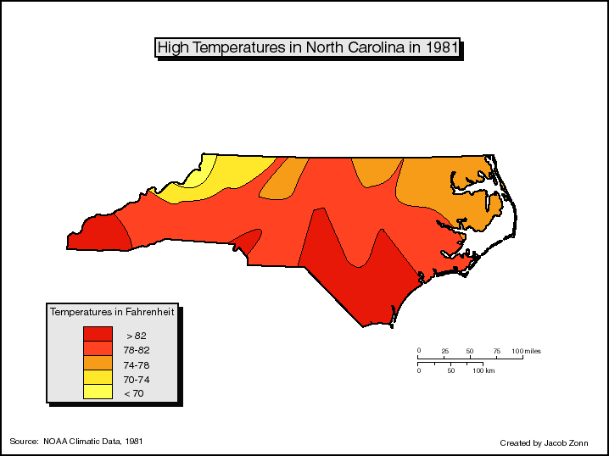
Contour Maps (Isopleths)
Isolines- Lines on a map depicting areas of same or like values.
Contour maps use isolines, or contour lines, to depict where the same elevation exists.
The contour interval of a contour map is the difference in elevation between successive contour lines.

Slide 18
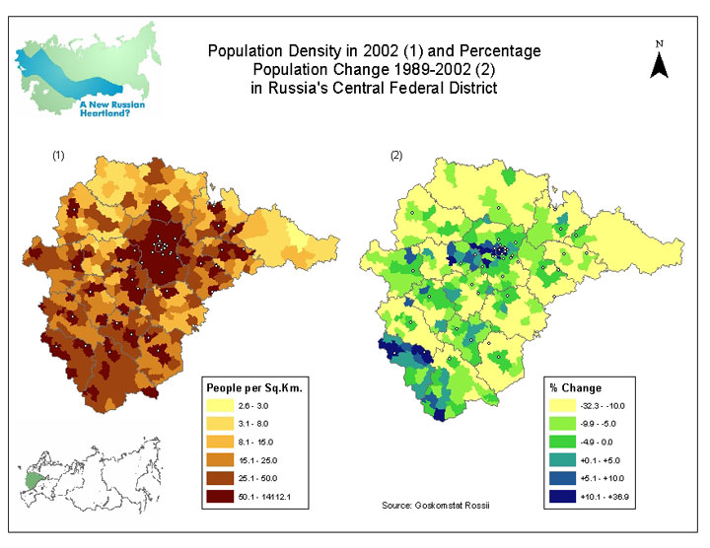
Choropleth Map
Shows statistical data aggregated over predefined regions, such as counties or states, by coloring or shading these regions.
For example, countries with higher rates of infant mortality might appear darker on a choropleth map.

Slide 19
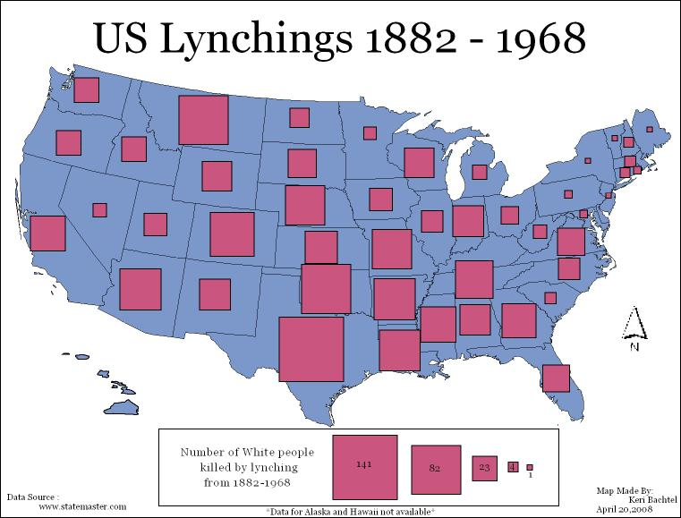
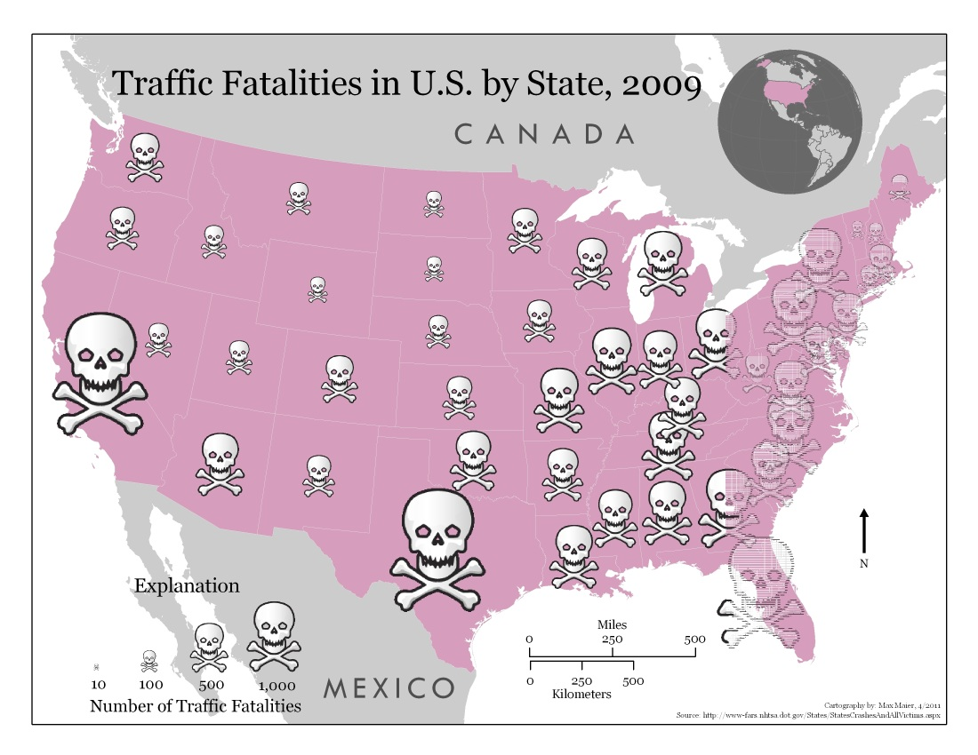
Proportional Symbols Map
The proportional symbol technique uses symbols of different sizes to represent data associated with different areas or locations within the map.

Slide 20
http://bcs.wiley.com/he-bcs/Books?action=mininav&bcsId=3206&itemId=0471701211&assetId=96271&resourceId=8133&newwindow=true

Slide 21
Scale
Displaying the same geographical features at various scales may also depict misleading results.

Slide 22
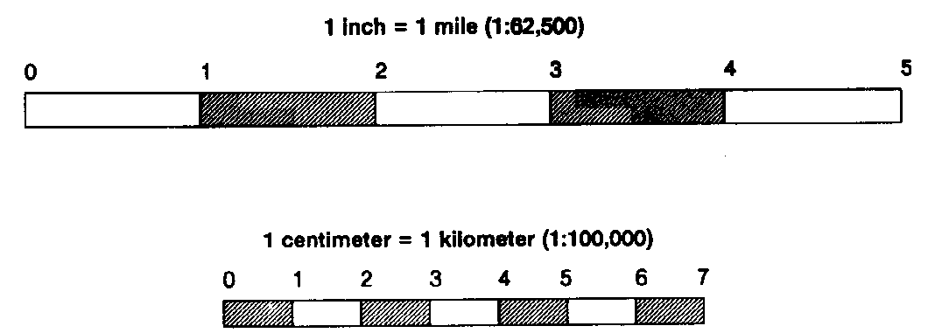
Map Scale
The degree to which a map “zooms in” on the area it is representing.
Scale tells you what extent the portion of the earth represented on the map has been reduced from its original size to fit on the map.

Slide 23
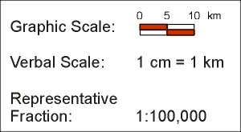
For example, 1 inch on a map may equal 10 miles in the real world.
  That scale might be written as 1 inch = 10 miles.
Sometimes, scale is indicated as a fraction.
  “1/10 miles” or “1:10 miles” means 1 inch on the map equals 10 miles in the real world.

Slide 24
THIS IS THE TRICKY PART
Counterintuitive part of mapping:
“LARGE” OR “SMALL” scale.
  The more “zoomed in” the map is on an area, the larger its map scale is.
    large-scale map depicts a smaller area
  The less “zoomed in” the map is on an area, the smaller is its scale.
    Small-scale map depicts a larger area

Slide 25
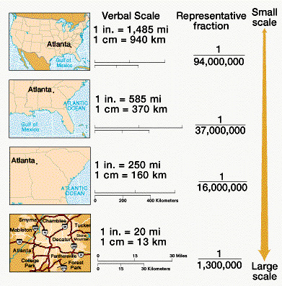

Slide 26
This map shows the total number of African-Americans per state. Examine Georgia.

Slide 27
In the previous slide, Georgia had one of the highest number of African-Americans, but a closer look tells a different picture. The dark red is the Atlanta metropolitan area.

Slide 28
Using Census Tracts of the Atlanta Metropolitan Area, a different scale gives different results.

Slide 30
Manipulating
Data
Data may also distort desired results. The following slides show how population of a particular cohort may be misleading.

Slide 31
This map shows the percentage of African-Americans living within counties across the US.

Slide 32
This map shows the total number of African-Americans living in each county across the US.

Slide 33
These four New York counties (New York, Kings, Queens, and Bronx) have a combined African-American population of 2,121,882 and outnumbers the total number of African-Americans in the entire state of Texas 2,021,632

